Slide 1

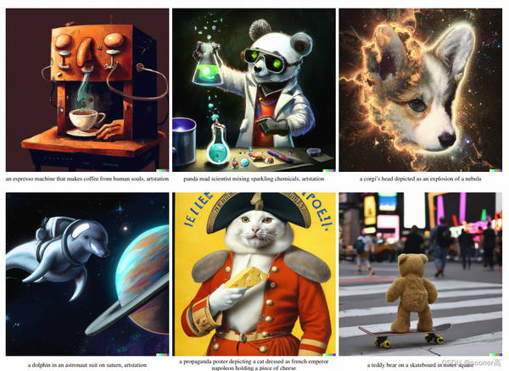
An Introduction to Diffusion Models for Text-to-Image Generation
Understanding DDPMs and Their Role in Generative AI
Ikne Omar
03.12.2024

Slide 2
Content
Generative Models
Diffusion Models:
Overview
Mathematical Foundation
Denoising Diffusion Probabilistic Models (DDPM)
Forward Process
Reverse Process
Training Process
Sampling Process
Conditioning on Text (Text-to-Image)
More advanced Diffusion Model
Challenges and Limitations
Additional Resources

Slide 3
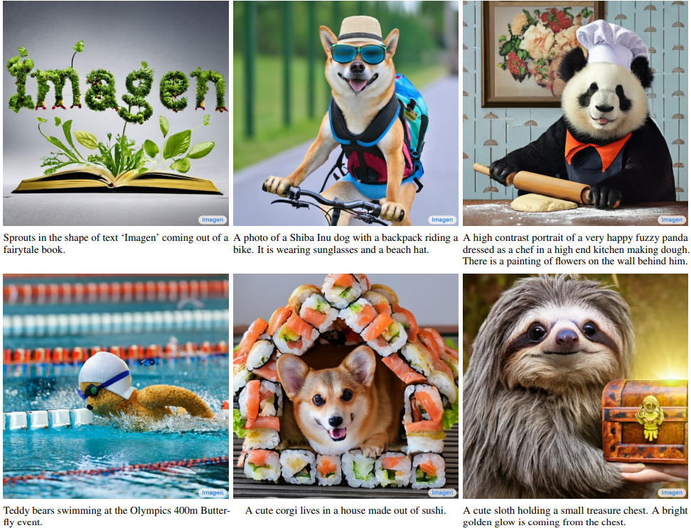
Generative Models
DALL-E (OpenAI), Stable Diffusion (Stability AI), Imagen (Google), etc
What are generative models?

Slide 4
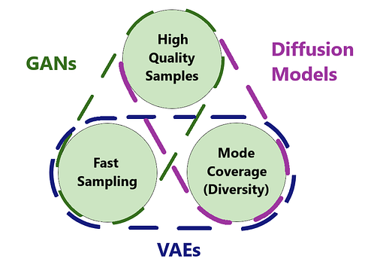
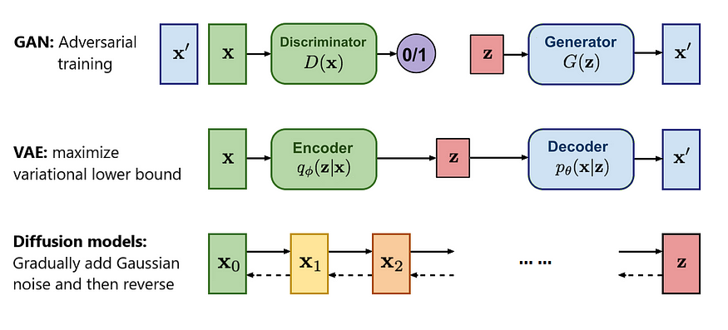
I. Generative Models: From GANs to VAEs to Diffusion Models
Diffusion models as a probabilistic, stable alternative.
Diffusion models are promising for high-quality generation

Slide 5
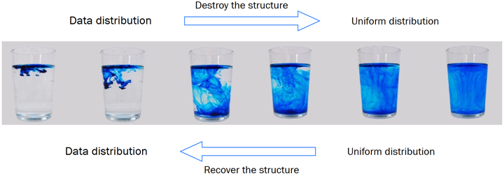
III. Diffusion Models: Overview
Key idea: Model data distribution by iteratively denoising samples from noise.
Process:
Forward process (adds noise).
Reverse process (learns to denoise).

Slide 6
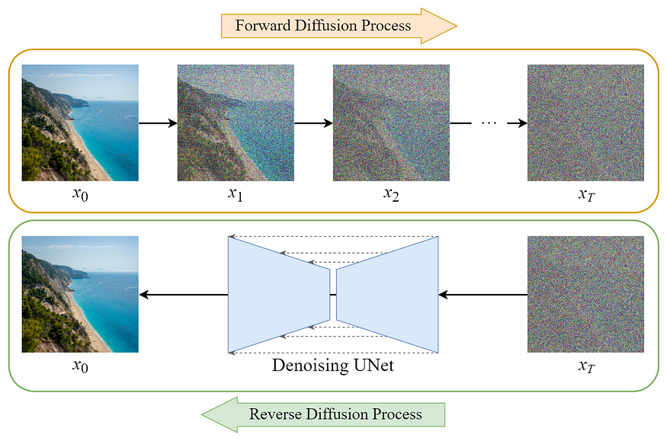
II. Diffusion Models: Overview
Key idea: Model data distribution by iteratively denoising samples from noise.
Process:
Forward process (adds noise).
Reverse process (learns to denoise).

Slide 7
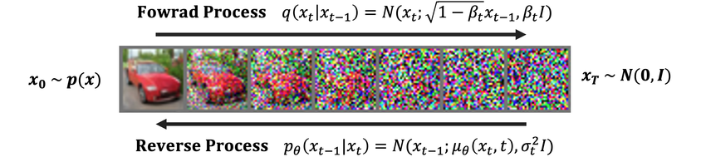
II. Diffusion Models: Mathematical Foundation
Diffusion models roughly consist of two parts:
A predefined forward process q(xt|xt−1) of our choosing, that gradually adds Gaussian noise to an image until it becomes pure noise.
A reverse denoising process p(xt−1|xt) , approximated by a neural network, which gradually denoises an image starting from pure noise.

Slide 8
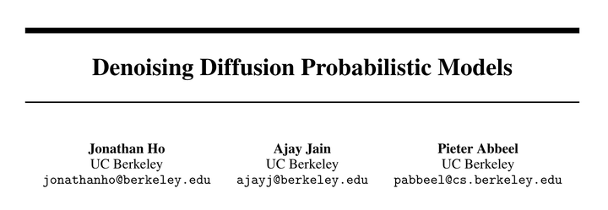
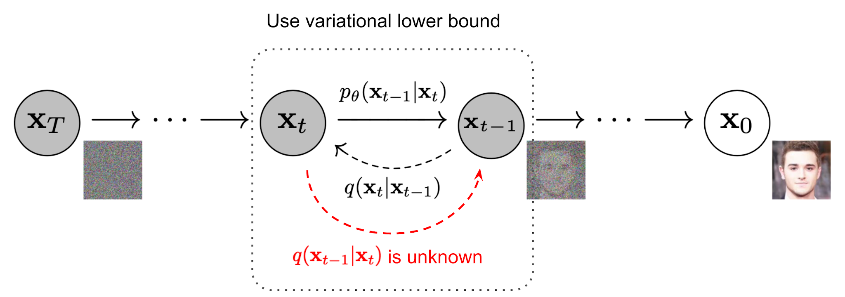
III. Denoising Diffusion Probabilistic Models
Denoising Diffusion Probabilistic Models (DDPM)
Introduced by Ho et al. (2020).
Architecture overview: Neural networks predict noise added at each timestep.
Benefits: High-quality, diverse outputs.

Slide 9
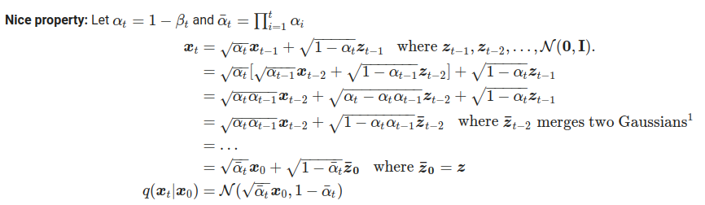
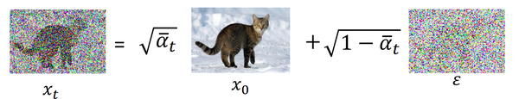
III. DDPM: Forward Process
Utility: Progressively adds Gaussian noise to data.

Slide 10
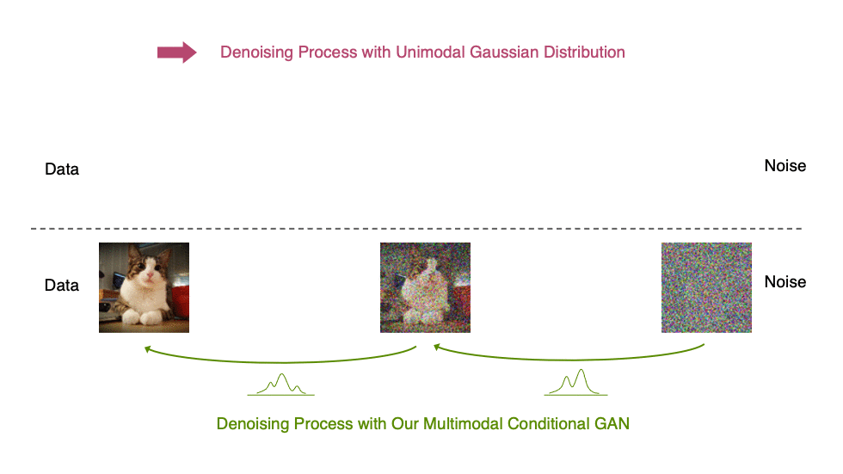
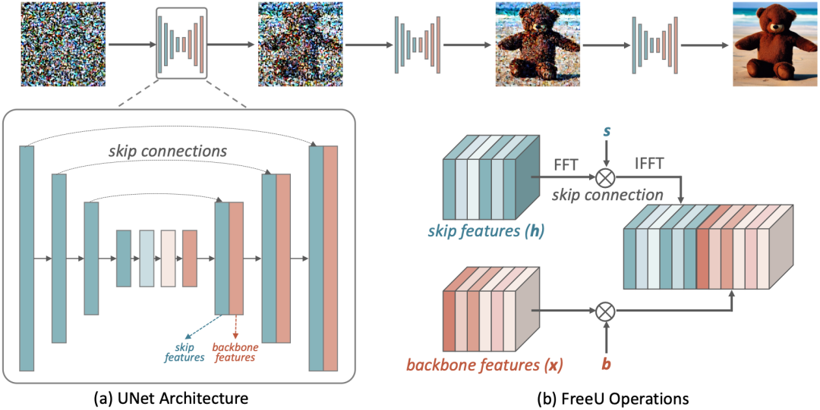
III. DDPM: Reverse Process
t=0
…
t=T-1
t=T
Utility: Learns to denoise and reconstruct data.
t=0
t=T-1
t=T
Encoder-Decoder Architecture: a contracting path (encoder) to capture context and an expansive path (decoder) for precise localization.
Skip Connections: Directly connects encoder layers to corresponding decoder layers, preserving high-resolution spatial features.
Versatile and Lightweight: Designed for high performance on pixel-wise tasks with relatively low computational requirements.

Slide 11
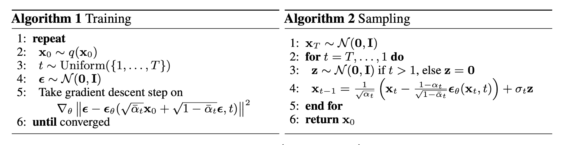
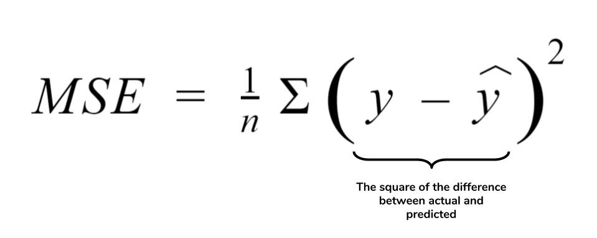
III. DDPM: Training Process
Training Algorithm
Training Loss
Mean squared error between predicted noise and true noise

Slide 12

III. DDPM: Sampling Process
Starts with random noise and applies reverse process iteratively.
Trade-off: Computational cost vs. quality.

Slide 13
IV. Conditioning on Text (Text-to-Image)
Key idea: Integrating text prompts into the model:
Text encoder extracts semantic features.
Cross-attention layers integrate text and image information.
“A smiling man's face”

Slide 14
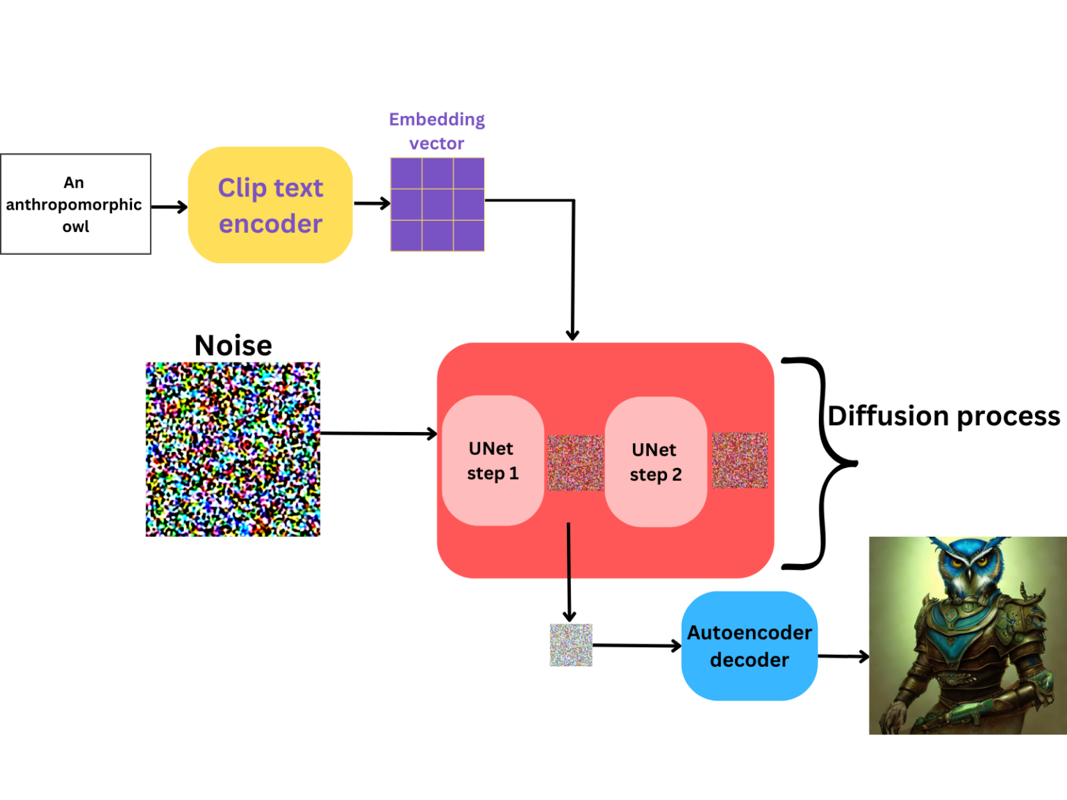
IV. Conditioning on Text (Text-to-Image)

Slide 15
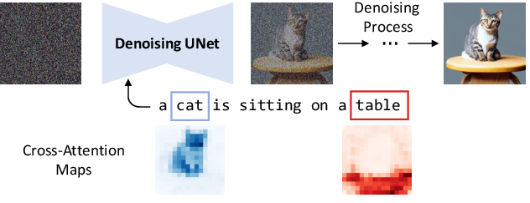
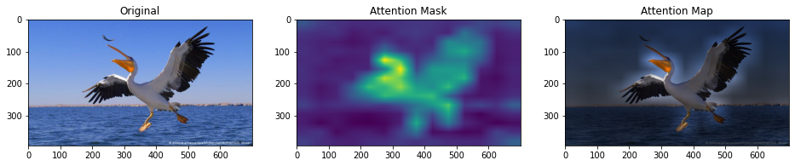
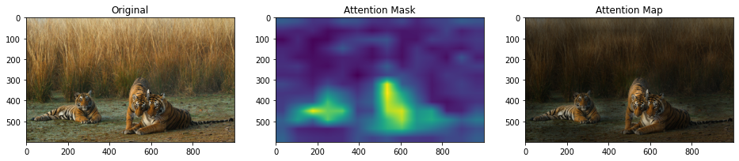
IV. Conditioning on Text (Text-to-Image)

Slide 16
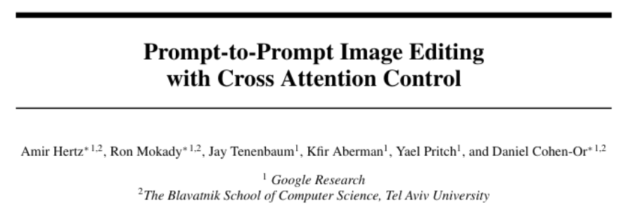
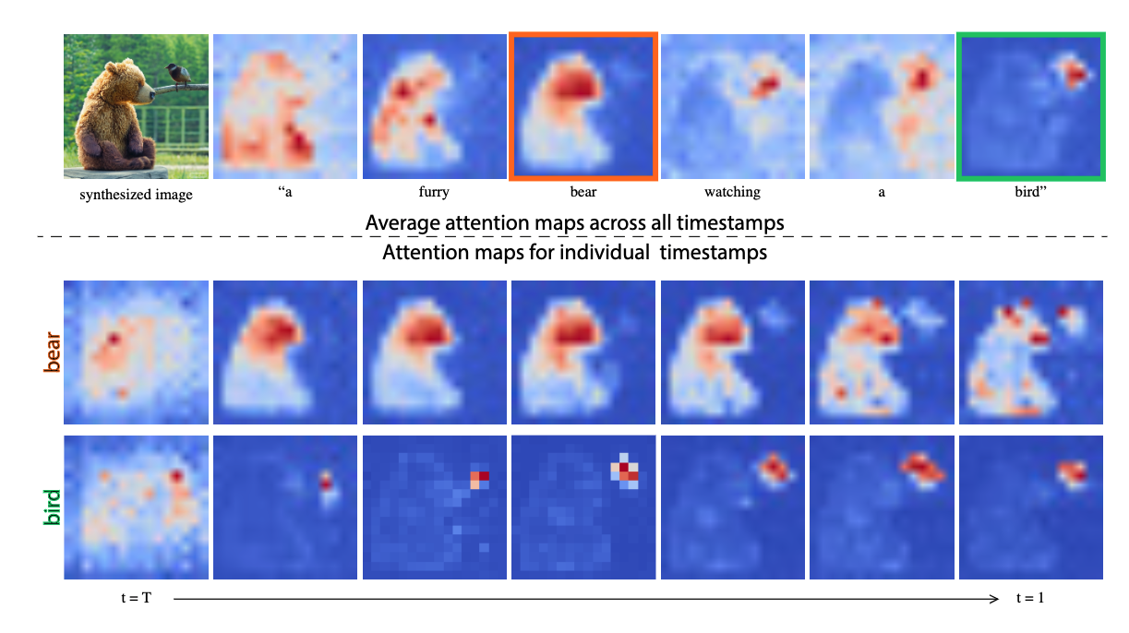
IV. Conditioning on Text (Text-to-Image)

Slide 17
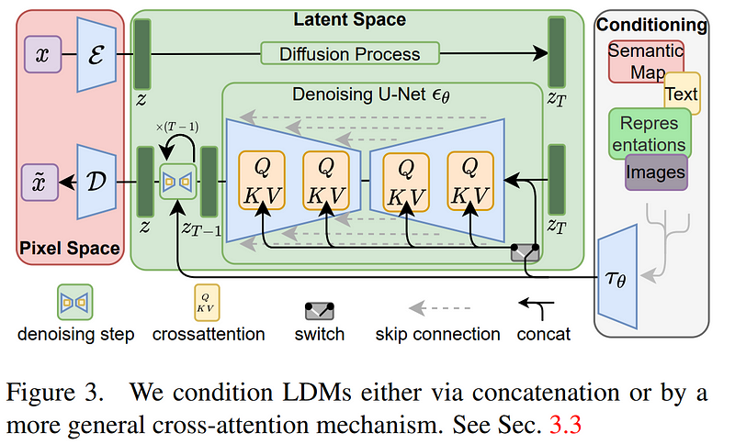
V. More advanced Diffusion Models
Latent diffusion model (basis of Stable Diffusion)

Slide 18
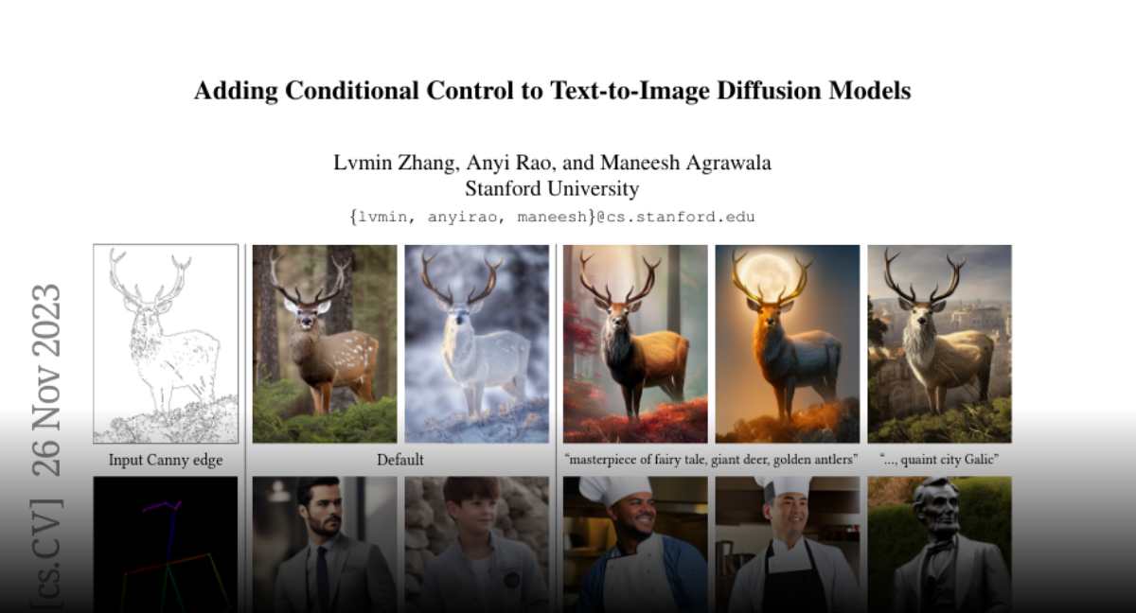
V. More advanced Diffusion Models

Slide 19
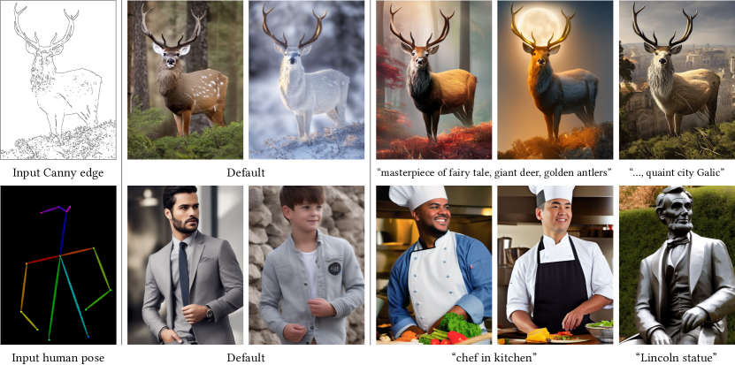
V. More advanced Diffusion Models
ControlNet

Slide 20
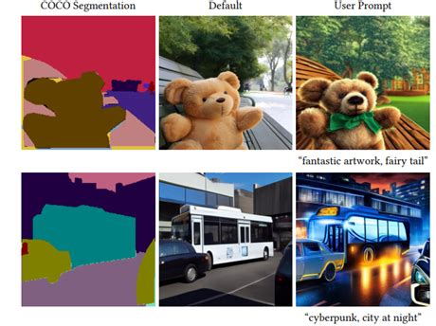
V. More advanced Diffusion Models
ControlNet

Slide 21
VI. Challenges and Limitations
High computational cost (training and sampling).
Interpretability issues.
Bias and ethical considerations in text prompts.

Slide 22
Additional Resources
https://github.com/Jackson-Kang/Pytorch-Diffusion-Model-Tutorial
https://github.com/dome272/Diffusion-Models-pytorch
https://medium.com/@shubham.ksingh.cer14/diffusion-models-from-scratch-in-pytorch-cb6d349c14be
https://nn.labml.ai/diffusion/ddpm/index.html

